Slide 1
Object-Oriented and
Classical Software Engineering
8th Edition, WCB/McGraw-Hill, 2010
Stephen R. Schach srs@vuse.vanderbilt.edu

Slide 2
CHAPTER 4
TEAMS

Slide 3
Overview
Team organization
Democratic team approach
Classical chief programmer team approach
Beyond chief programmer and democratic teams
Synchronize-and-stabilize teams
Teams for agile processes
Open-source programming teams
People capability maturity model
Choosing an appropriate team organization

Slide 4
Team Organization
A product must be completed within 3 months, but 1 person-year of programming is still needed
Solution:
  If one programmer can code the product in 1 year, four programmers can do it in 3 months
Nonsense!
  Four programmers will probably take nearly a year
  The quality of the product is usually lower

Slide 5
Task Sharing
If one farm hand can pick a strawberry field in 10 days, ten farm hands can pick the same strawberry field in 1 day
One elephant can produce a calf in 22 months, but 22 elephants cannot possibly produce that calf in 1 month

Slide 6
Task Sharing (contd)
Unlike elephant production, it is possible to share coding tasks between members of a team
Unlike strawberry picking, team members must interact in a meaningful and effective way

Slide 7
Programming Team Organization
Example:
  Sheila and Harry code two modules, m1 and m2, say
What can go wrong
  Both Sheila and Harry may code m1, and ignore m2
  Sheila may code m1, Harry may code m2. When m1 calls m2 it passes 4 parameters; but m2 requires 5 parameters
  Or, the order of parameters in m1 and m2 may be different
  Or, the order may be same, but the data types may be slightly different

Slide 8
Programming Team Organization (contd)
This has nothing whatsoever to do with technical competency
  Team organization is a managerial issue

Slide 9
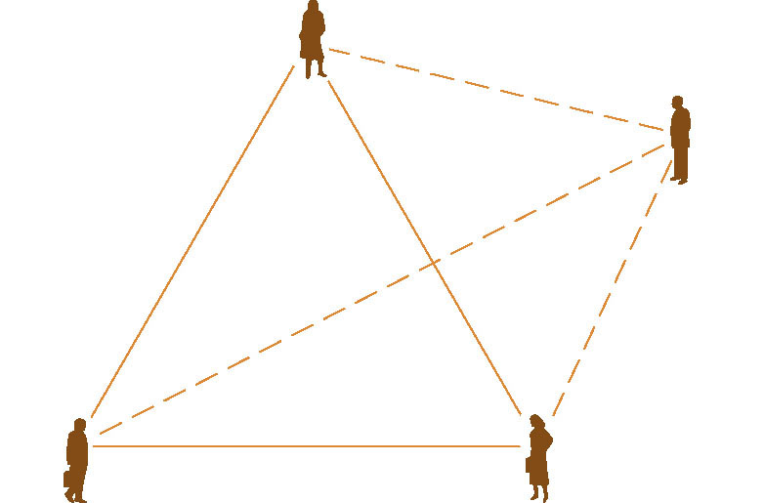
Communications Problems
Example
  There are three channels of communication between the three programmers working on a project. The deadline is rapidly approaching but the code is not nearly complete
“Obvious” solution:
  Add a fourth programmer to the team
Figure 4.1

Slide 10
Communications Problems (contd)
But other three have to explain in detail
  What has been accomplished
  What is still incomplete
Brooks’s Law
  Adding additional programming personnel to a team when a product is late has the effect of making the product even later

Slide 11
Team Organization
Teams are used throughout the software production process
  But especially during implementation
  Here, the discussion is presented within the context of programming teams
Two extreme approaches to team organization
  Democratic teams (Weinberg, 1971)
  Chief programmer teams (Brooks, 1971; Baker, 1972)

Slide 12
Democratic Team Approach
Basic underlying concept — egoless programming
Programmers can be highly attached to their code
  They even name their modules after themselves
  They see their modules as extension of themselves

Slide 13
Democratic Team Approach (contd)
If a programmer sees a module as an extension of his/her ego, he/she is not going to try to find all the errors in “his”/“her” code
  If there is an error, it is termed a bug 
  The fault could have been prevented if the code had been better guarded against the “bug”
  “Shoo-Bug” aerosol spray

Slide 14
Democratic Team Approach (contd)
Proposed solution
Egoless programming
  Restructure the social environment
  Restructure programmers’ values
  Encourage team members to find faults in code
  A fault must be considered a normal and accepted event
  The team as whole will develop an ethos, a group identity
  Modules will “belong” to the team as whole
  A group of up to 10 egoless programmers constitutes a democratic team

Slide 15
Difficulties with Democratic Team Approach
Management may have difficulties
  Democratic teams are hard to introduce into an undemocratic environment

Slide 16
Strengths of Democratic Team Approach
Democratic teams are enormously productive
They work best when the problem is difficult
They function well in a research environment
Problem:
  Democratic teams have to spring up spontaneously

Slide 17
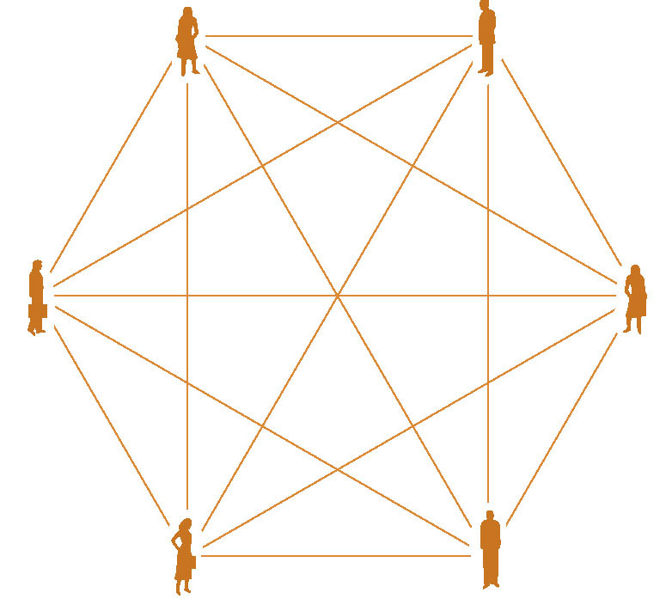
Classical Chief Programmer Team Approach
Consider a 6-person team
  Fifteen 2-person communication channels
  The total number of 2-, 3-, 4-, 5-, and 6-person groups is 57
  This team cannot do 6 person-months of work in 1 month
Figure 4.2

Slide 18
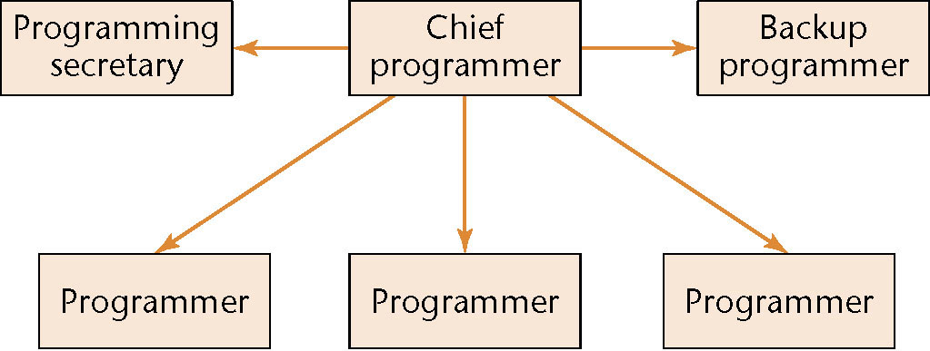
Classical Chief Programmer Team
Figure 4.3
Six programmers, but now only 5 lines of communication

Slide 19
Classical Chief Programmer Team (contd)
The basic idea behind the concept
  Analogy: chief surgeon directing an operation, assisted by
    Other surgeons
    Anesthesiologists
    Nurses
    Other experts, such as cardiologists, nephrologists
Two key aspects
  Specialization
  Hierarchy

Slide 20
Classical Chief Programmer Team (contd)
Chief programmer
  Successful manager and highly skilled programmer
  Does the architectural design
  Allocates coding among the team members
  Writes the critical (or complex) sections of the code
  Handles all the interfacing issues
  Reviews the work of the other team members
  Is personally responsible for every line of code

Slide 21
Classical Chief Programmer Team (contd)
Back-up programmer
  Necessary only because the chief programmer is human
  The back-up programmer must be in every way as competent as the chief programmer, and
  Must know as much about the project as the chief programmer
  The back-up programmer does black-box test case planning and other tasks that are independent of the design process

Slide 22
Classical Chief Programmer Team (contd)
Programming secretary
  A highly skilled, well paid, central member of the chief programmer team
  Responsible for maintaining the program production library (documentation of the project), including:
    Source code listings
    JCL
    Test data
  Programmers hand their source code to the secretary who is responsible for
    Conversion to machine-readable form
    Compilation, linking, loading, execution, and running test cases (this was 1971, remember!)

Slide 23
Classical Chief Programmer Team (contd)
Programmers
  Do nothing but program
  All other aspects are handled by the programming secretary

Slide 24
Impracticality of Classical CPT
The chief programmer must be a highly skilled programmer and a successful manager
There is a shortage of highly skilled programmers
There is a shortage of successful managers
The qualities needed to be a highly skilled programmer are unlikely to be found in a successful manager, and vice versa

Slide 25
Impracticality of Classical CPT (contd)
The back-up programmer must be as good as the chief programmer
  But he/she must take a back seat (and a lower salary) waiting for something to happen to the chief programmer
  Top programmers, top managers will not do that
The programming secretary does nothing but paperwork all day
  Software professionals hate paperwork
Classical CPT is impractical

Slide 26
Beyond CP and Democratic Teams
We need ways to organize teams that
  Make use of the strengths of democratic teams and chief programmer teams, and
  Can handle teams of 20 (or 120) programmers
A strength of democratic teams
  A positive attitude to finding faults
Use CPT in conjunction with code walkthroughs or inspections

Slide 27
Beyond CP and Democratic Teams (contd)
Potential pitfall
The chief programmer is personally responsible for every line of code
  He/she must therefore be present at reviews
The chief programmer is also the team manager
  He/she must therefore not be present at reviews!

Slide 28
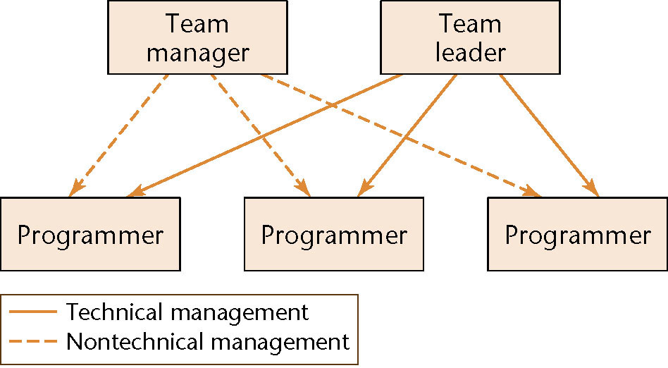
Beyond CP and Democratic Teams (contd)
Figure 4.4
Solution
  Reduce the managerial role of the chief programmer

Slide 29
Beyond CP and Democratic Teams (contd)
It is easier to find a team leader than a chief programmer
Each employee is responsible to exactly one manager — lines of responsibility are clearly delineated
The team leader is responsible for only technical management

Slide 30
Beyond CP and Democratic Teams (contd)
Budgetary and legal issues, and performance appraisal are not handled by the team leader
The team leader participates in reviews — the team manager is not permitted to do so
The team manager participates in regular team meetings to appraise the technical skills of the team members

Slide 31
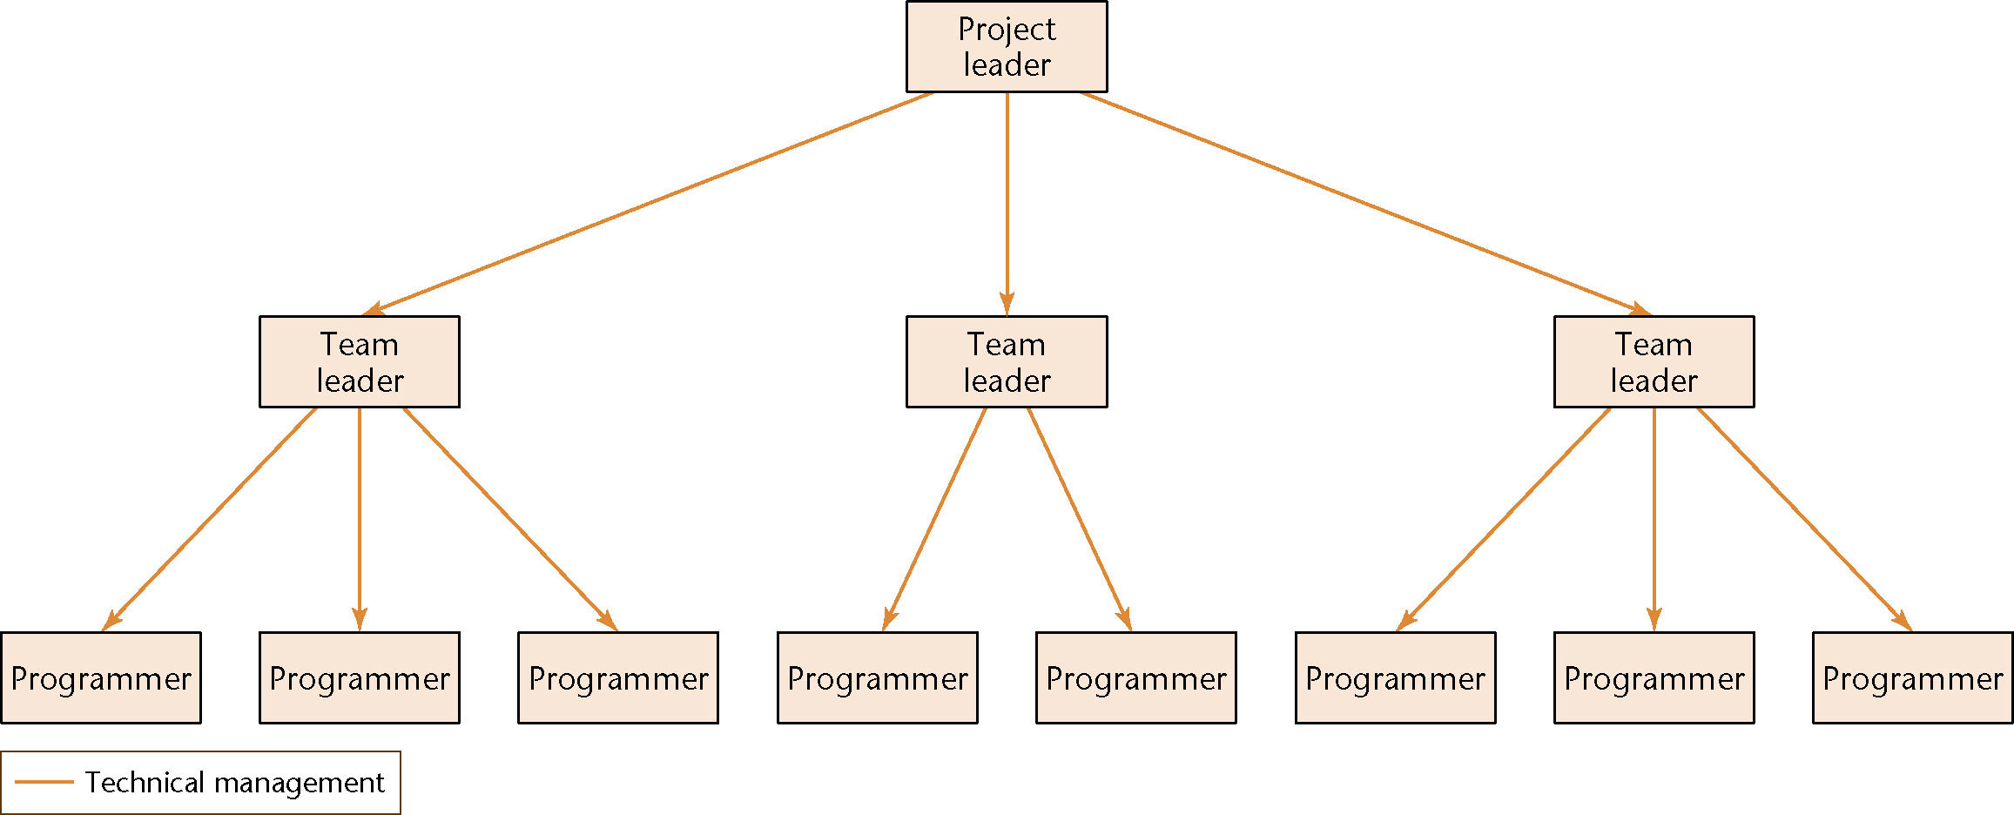
Larger Projects
Figure 4.5
The nontechnical side is similar
  For even larger products, add additional layers

Slide 32
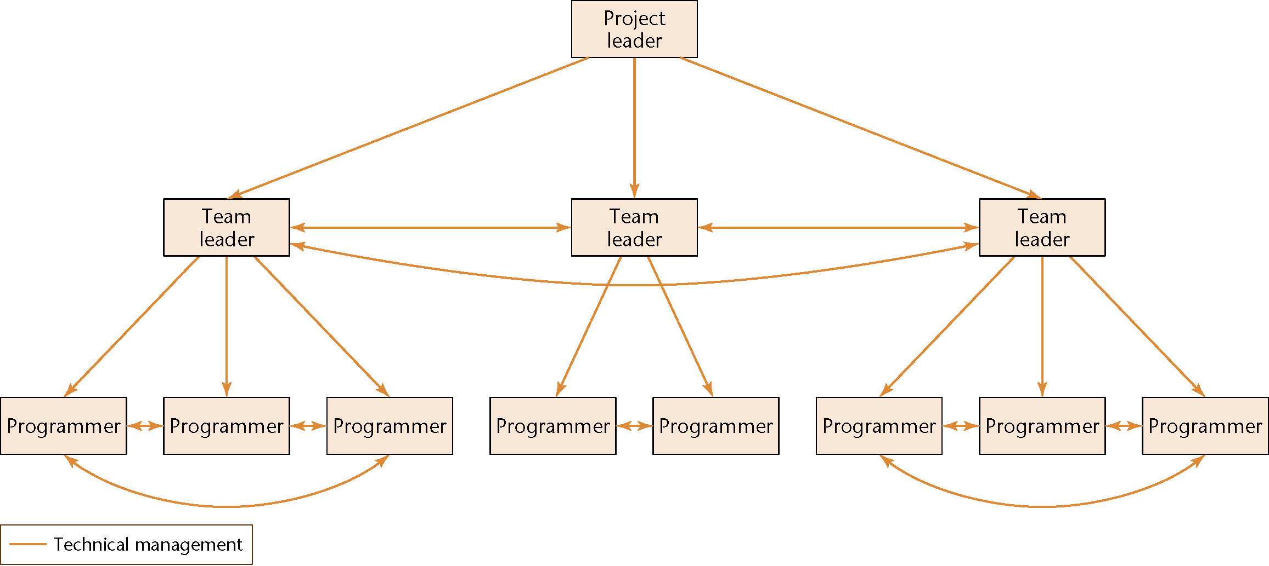
Beyond CP and Democratic Teams (contd)
Figure 4.6
Decentralize the decision-making process, where appropriate
  Useful where the democratic team is good

Slide 33
People Capability Maturity Model
Best practices for managing and developing the workforce of an organization
Each maturity level has its own KPAs
  Level 2: Staffing, communication and coordination, training and development, work environment, performance management, coordination
  Level 5: Continuous capability improvement, organizational performance alignment, continuous workforce innovation

Slide 34
People Capability Maturity Model (contd)
P–CMM is a framework for improving an organization’s processes for managing and developing its workforce
No one specific approach to team organization is put forward

Slide 35
Choosing an Appropriate Team Organization
There is no one solution to the problem of team organization
The “correct” way depends on
  The product
  The outlook of the leaders of the organization
  Previous experience with various team structures

Slide 36
Choosing an Appropriate Team Organization (contd)
Exceedingly little research has been done on software team organization
  Instead, team organization has been based on research on group dynamics in general
Without relevant experimental results, it is hard to determine optimal team organization for a specific product

